Slide 1
Managing IoT Assets with Node.js and DocumentDB
Joshua Davis, MCT, MCSD (x2), MCPD (x2), CSM, CSPO MTC Cloud Solutions Architect – Atlanta, GA

Slide 2

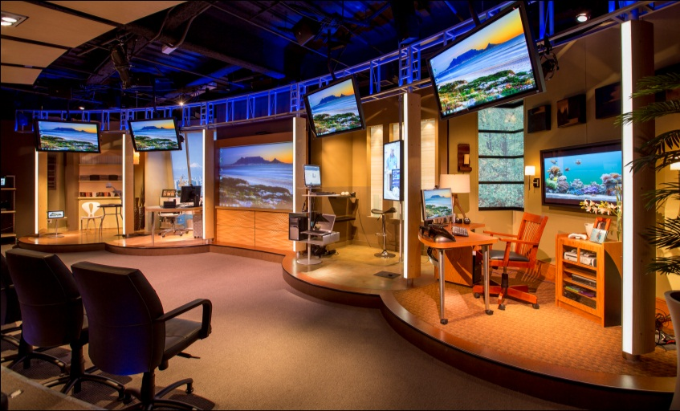
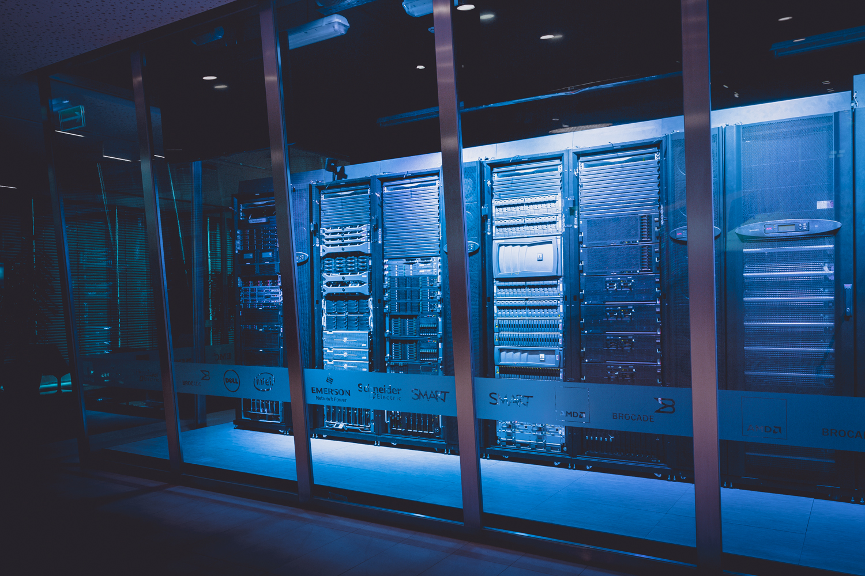
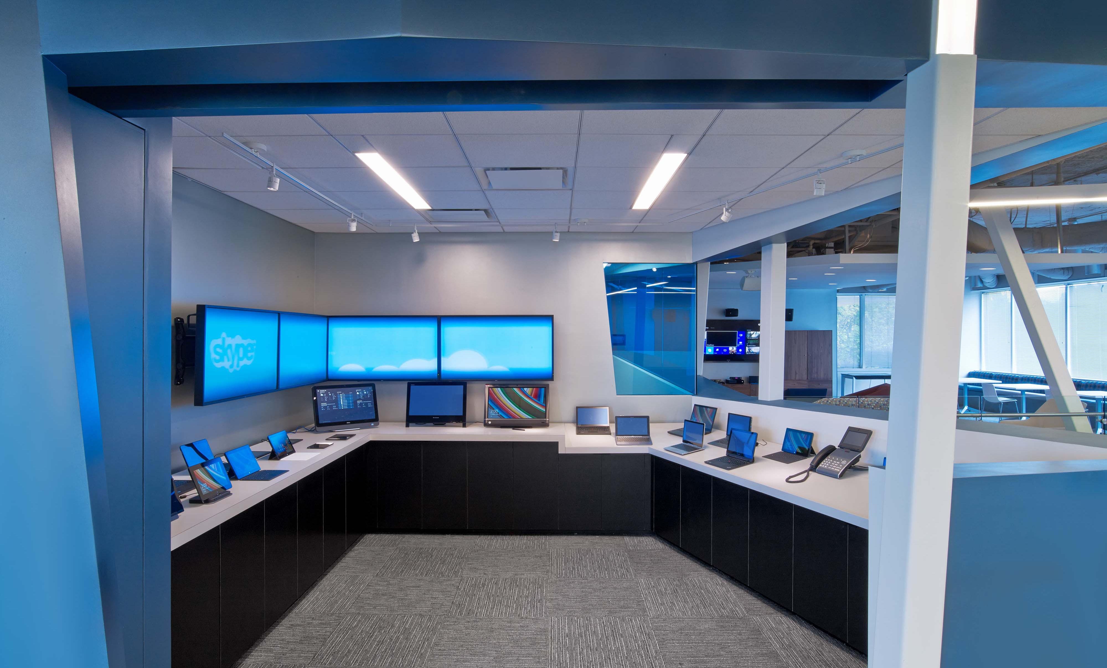
A Powerful Combination of Resources
Global Availability
Immersive Engagements
To explore the potential impact of cloud, mobile & social solutions to your business contact your account manager.
To learn more about the 40+ WW MTCs go to
www.microsoft.com/mtc or scan the QR code as you exit.
Technical Expertise & Industry Alliances
Interactive Experiences
Notes:
Microsoft Technology Centers (MTCs) are collaborative environments that provide access to innovative technologies and world-class expertise, enabling you to envision, design, and deploy solutions to meet your exact needs.
State of the Art facilities
Envision what is possible
Immersive, hands-on experience
A Proven path that works.

Slide 3
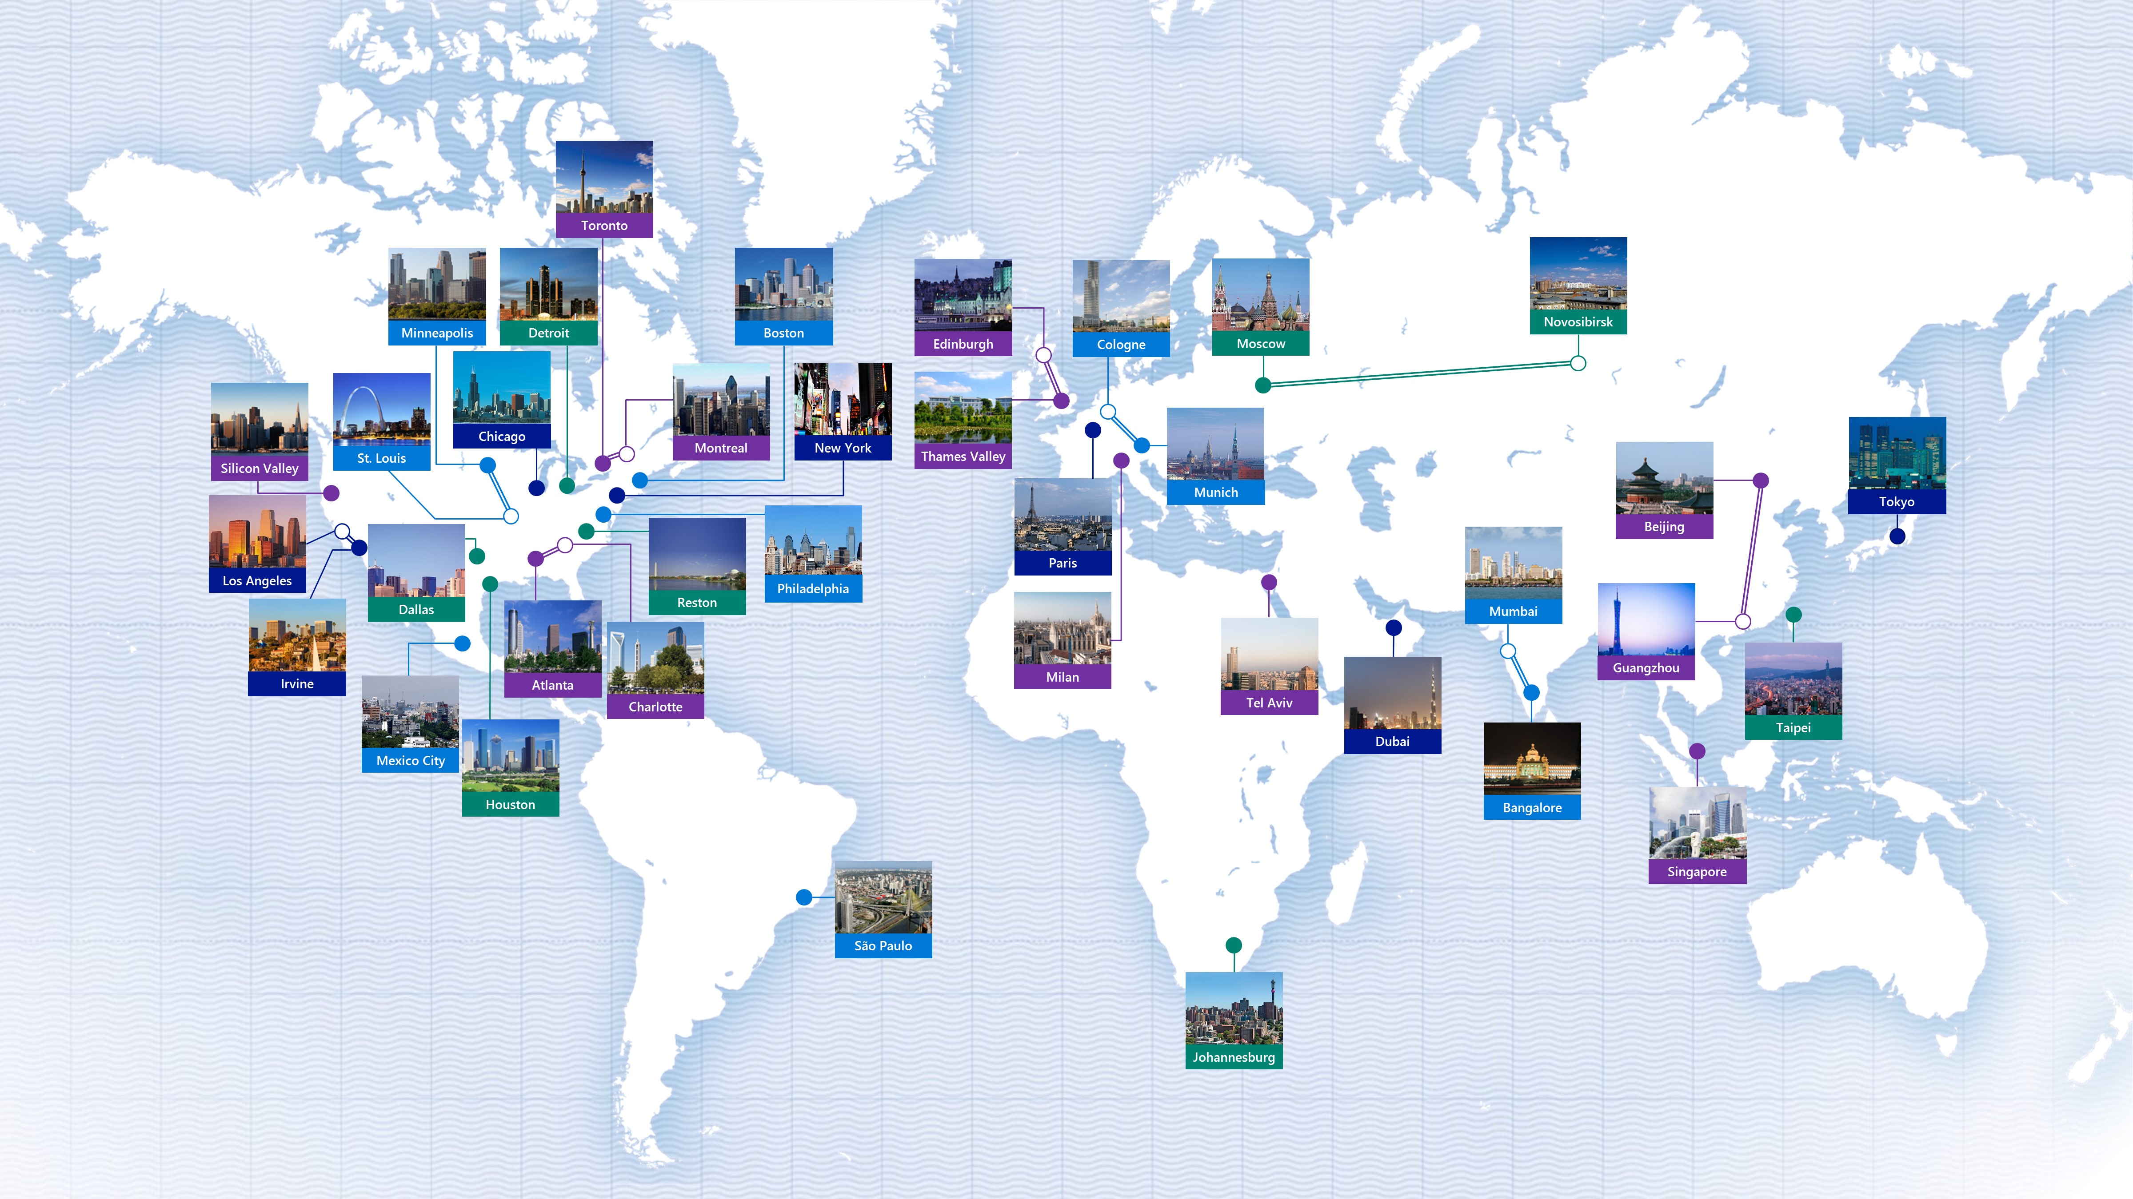

Microsoft Technology Centers

Slide 4
Microsoft Open Source
Visual Studio Code (http://code.visualstudio.com)
Largest Number of GitHub Contributors

Slide 5
Asset Management

Slide 6
Asset Management
Business Requirements
Manage Assets
Real-time Asset Location within a Geo-Fence
User Authentication
Platform Agnostic
Repository Versatility

Slide 7
Asset Management
Functional Specifications
Node.js Backend
Angular 2 Frontend
JSON Web Tokens (JWT) for Authentication
Repository – MongoDB or DocumentDB
Hosting Provider – Heroku or Azure
IoT Hub, Stream Analytics

Slide 8



Architectural Design
Web Application
User
Angular2
Node.js
(Heroku/Azure)
NoSql
(MongoDB/ DocumentDB)

Slide 9
Web Application Demo

Slide 10
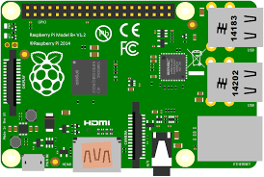


Architectural Design
IoT Asset Tracking
User
Angular2
Node.js
Raspberry Pi’s
(Heroku/Azure)
NoSql
(MongoDB/ DocumentDB)
IoT Hub
Stream Analytics

Slide 11
Bluetooth
Typical Broadcasts
MAC Address
Received Signal Strength Indicator (RSSI)

Slide 12
Bluetooth
iBeacon Broadcasts
UUID
Received Signal Strength Indicator (RSSI)
Measured Power (Calibrated at 1m)
Accuracy
Proximity
Immediate (~ few cm’s)
Near (~ few m’s)
Far ( > 10 m’s)

Slide 13
IoT/iBeacon Demo

Slide 14
Bluetooth
iBeacon Security
Can be Imitated/Faked
Handshaking?

Slide 15
Asset Tracking
Potential Use Cases
Tracking Physical Assets
Theft Prevention
People Tracking
Patients
Students
Inmates

Slide 16
Asset Tracking Project
Next Steps
Provide Steps for Deployments
Heroku
Azure Service Fabric
Create Unit Tests
Triangulate Positions

Slide 17
Project Url
http://jdav.is/ignite16-iot

Slide 18
Joshua Davis
Email: josdavis@microsoft.com
Blog: http://jdav.is
LinkedIn: http://linkedin.com/in/joshuajdavis

